Slide 1

Scala Crash Course

Slide 2
What is Scala?
Functional programming language (passing functions around)
Object oriented language
Runs on top of JVM
Write less code

Slide 3
Scala REPL
Q&A
Binaries from https://www.scala-lang.org/download/
Set SCALA_HOME + PATH environment variables
Type scala from a command line.

Slide 4
Scala Basics
Download the starting code from GitHub:
git clone https://github.com/bogdannb/scala_spark_course.git
Scala Worksheets in Intelijj. Set Scala SDK to Scala 2.11
var (mutable) vs val (immutable)
Types: String, Int, Boolean, Char, Double, Float, Long, Byte

Slide 5
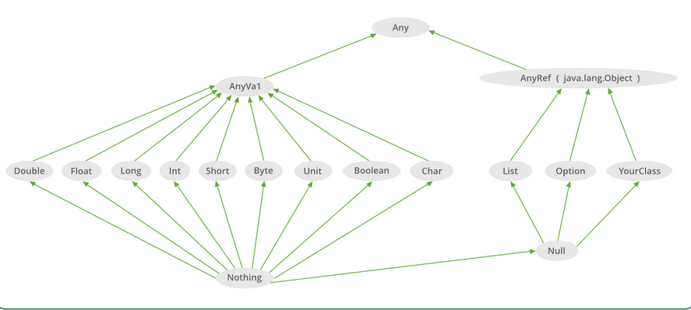
Scala Type Hierarchy

Slide 6
Scala Basics
Formatting
Padding
Interpolation (substitution)
See also https://docs.scala-lang.org/overviews/core/string-interpolation.html for more documentation
Regex - a bit weird, as weird as Scala gets ☺
Boolean operators
Exercise + solution

Slide 7
Scala Flow Control
if, if-else
match
for loops with range operator
while loops
do-while
automatic return + first example of a function passed to another function
Fibonnaci exercise + solution

Slide 8
Scala Functions
Anatomy of a function
Passing functions as parameters
Lambda functions (anonymous function, function literals)
Exercise + solution

Slide 9
Data structure
Tuples = immutable lists
Tuples are used a lot in Spark
Fields of tuples are 1-based
List, functions over lists, lost of functions in Scala ☺
Maps
Try syntax
Other structures – during the course
Exercise + solution

